Slide 1




Name: Doshi Devam Dharmeshbhai
Enrollment No: 24002171310033
Batch – C7
Branch - CST
Byteblast GameHub

Slide 2


Introduction to ByteBlast GameHub
ByteBlast GameHub is an innovative gaming platform that offers an exciting collection of games along with a unique token system. Players can earn money using tokens by participating in various games across the platform.

Slide 3

Overview of the Token System
Enhanced Gaming Experience
Rewards and Prizes
Progress Tracking
Through the token system, players can access exclusive game , adding depth to their gaming experience.
Accumulated tokens can be redeemed to exchange money enhancing the competitive spirit.
Players can check their Token Balance anytime at the main menu.

Slide 4
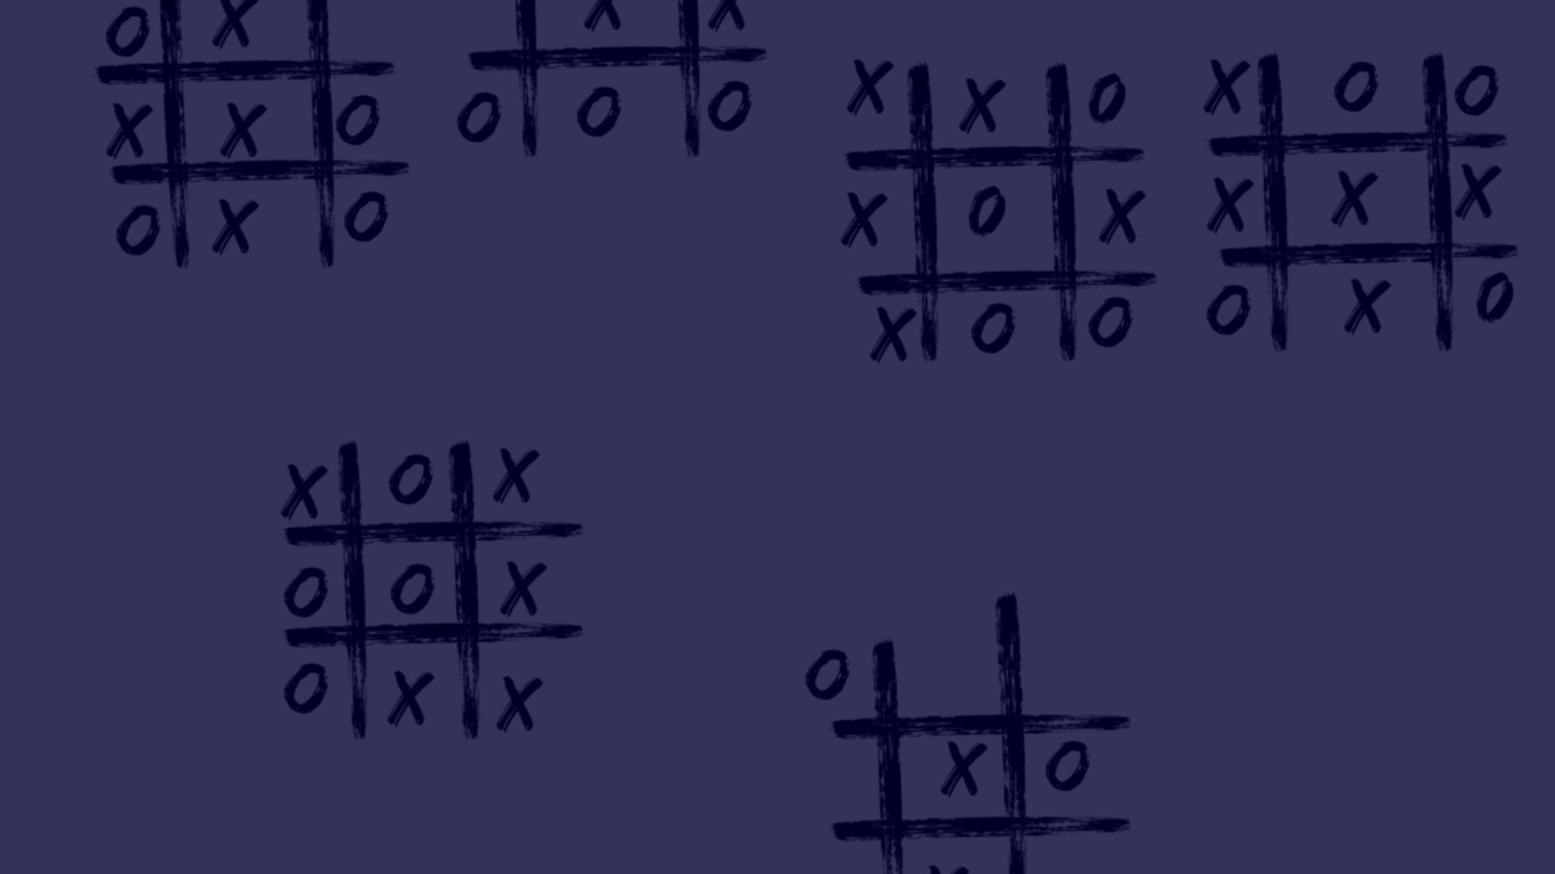
Game 1: Tic Tac Toe
1
Classic Fun
2
Strategic Gameplay
3
Play Against Computer
Tic Tac Toe is a beloved game enjoyed by players of all ages, providing endless entertainment and mental stimulation.
Master the art of strategy and critical thinking while playing Tic Tac Toe, making it an excellent skill-building game.
Engage in thrilling matches against smart computer and defeat it to earn tokens.

Slide 5
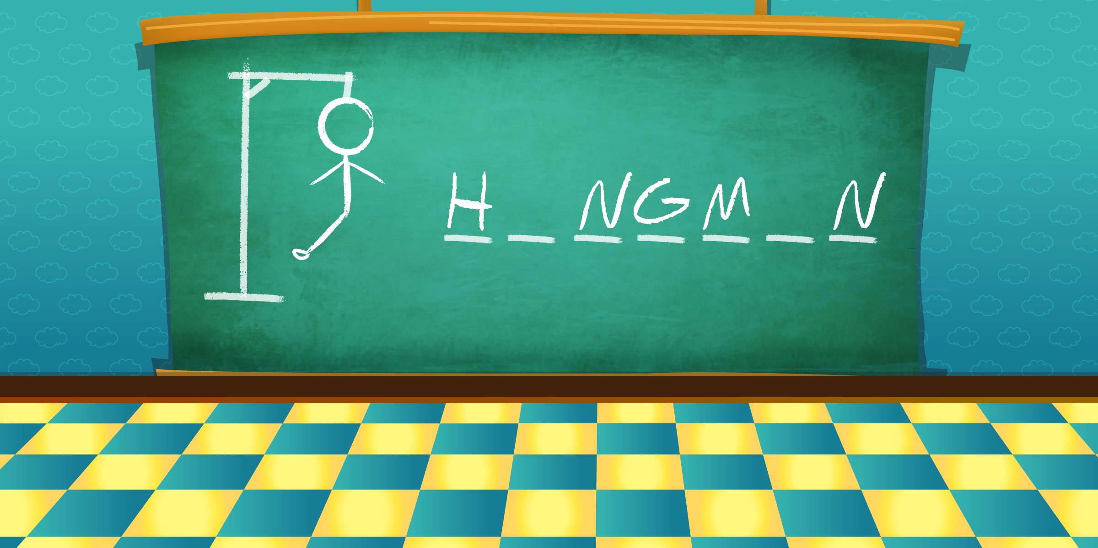
Game 2: Hangman
1
Word Mastery
2
Thrilling Challenge
Hone your vocabulary and language skills while solving intriguing word puzzles in the classic game of Hangman.
Experience the suspense and excitement of unraveling words letter by letter, providing a truly engaging gaming experience.

Slide 6
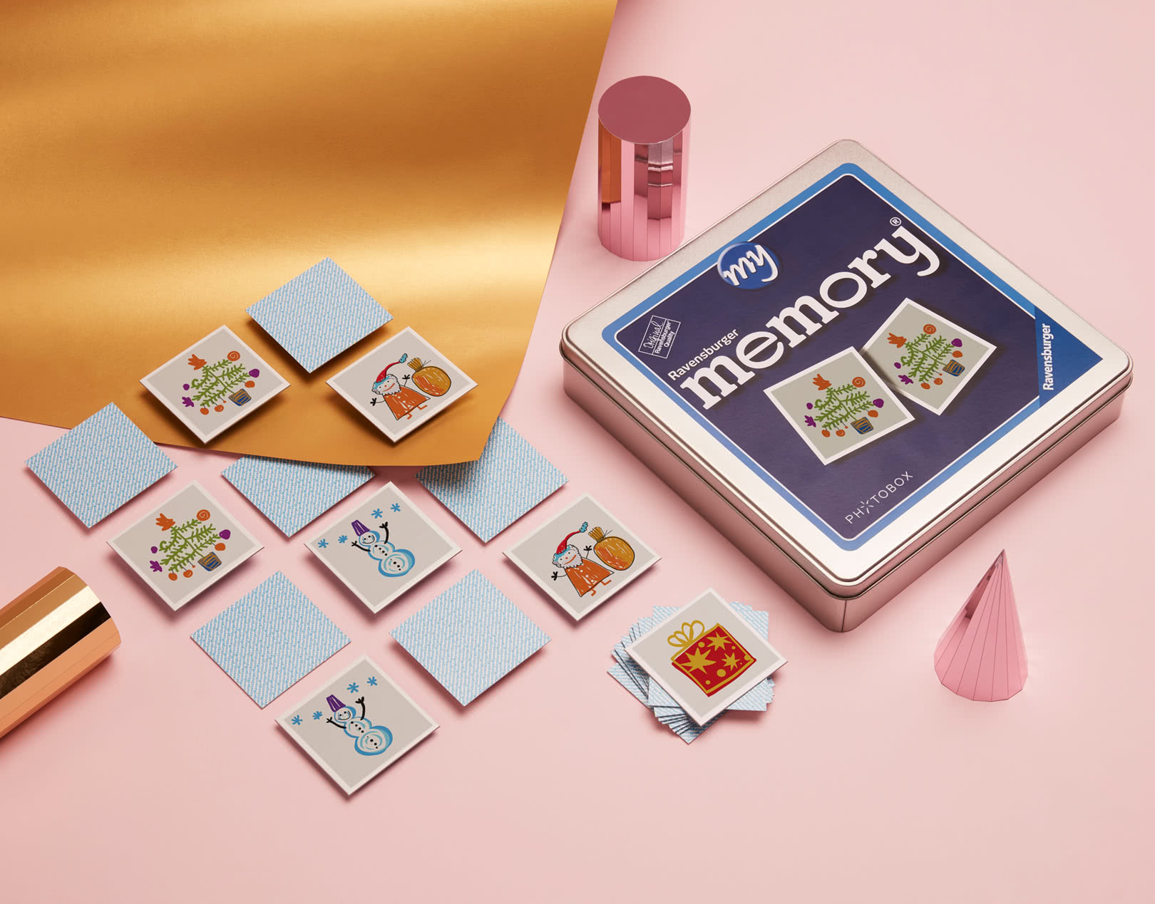




Game 3: Memory Game
Enhance Memory and Focus
Interactive Matching Experience
Card memory games require players to remember the locations of matching pairs, improving cognitive skills like memory retention and concentration.
Card memory games provide an interactive experience where players uncover and match pairs of cards, fostering engagement and enjoyment through the thrill of discovery and strategy.

Slide 7
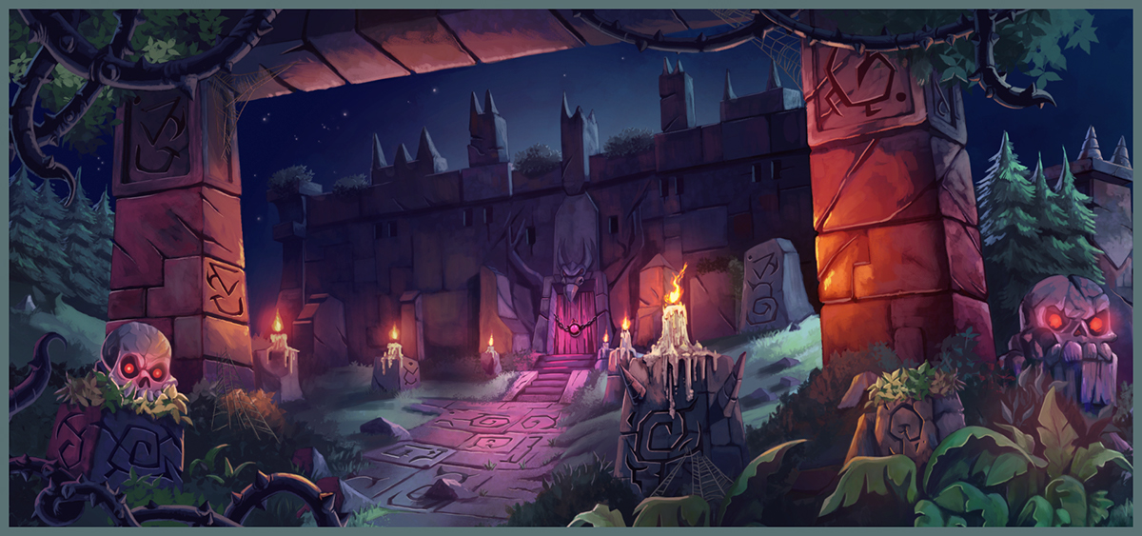
Game 4: Dungeon Rush
Action-Packed Adventure
Strategic Decision-Making
Embark on an epic text-based game through treacherous dungeons filled with mysteries, traps, and hidden treasures, creating a thrilling and immersive gaming experience.
Test your strategic prowess and tactical abilities as you navigate perilous dungeon levels and overcome formidable foes, ensuring every move counts and test your luck.

Slide 8
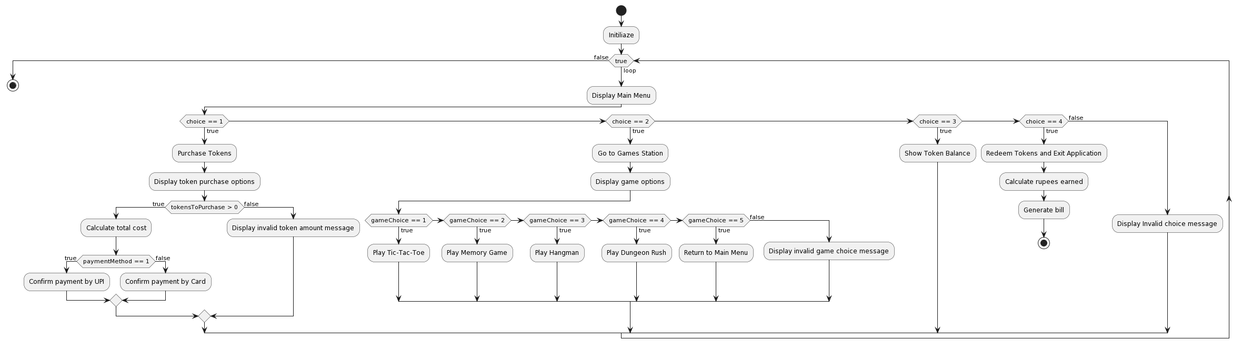
Flow Chart

Slide 9
THANK YOU

